Slide 1
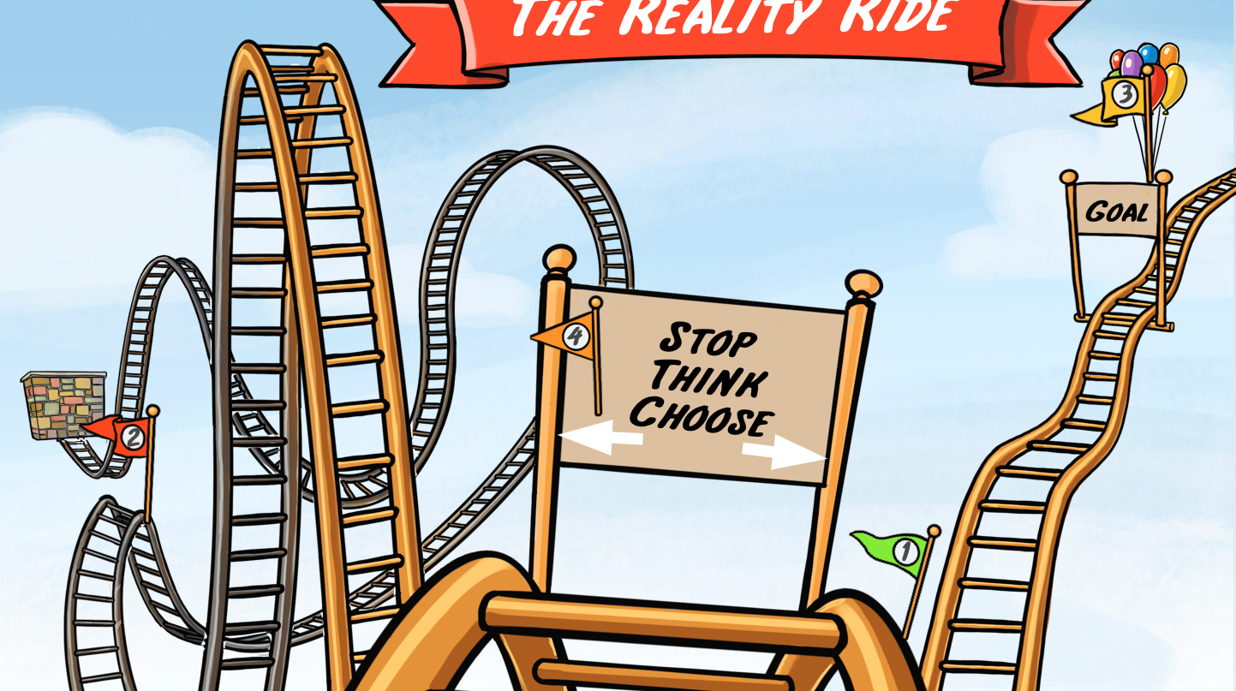
The Reality Ride
Grades 1-2

Slide 2
ACTIVITY:
CHOOSE YOUR PATH

Slide 3
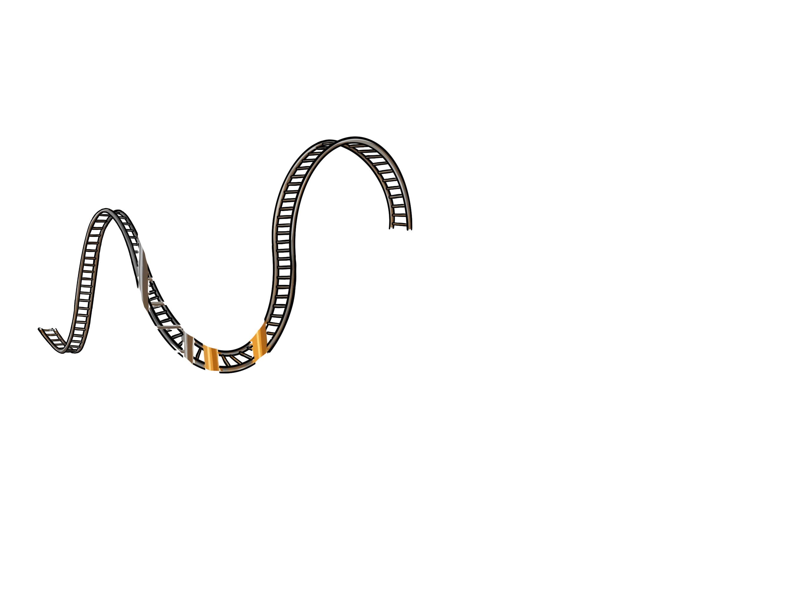
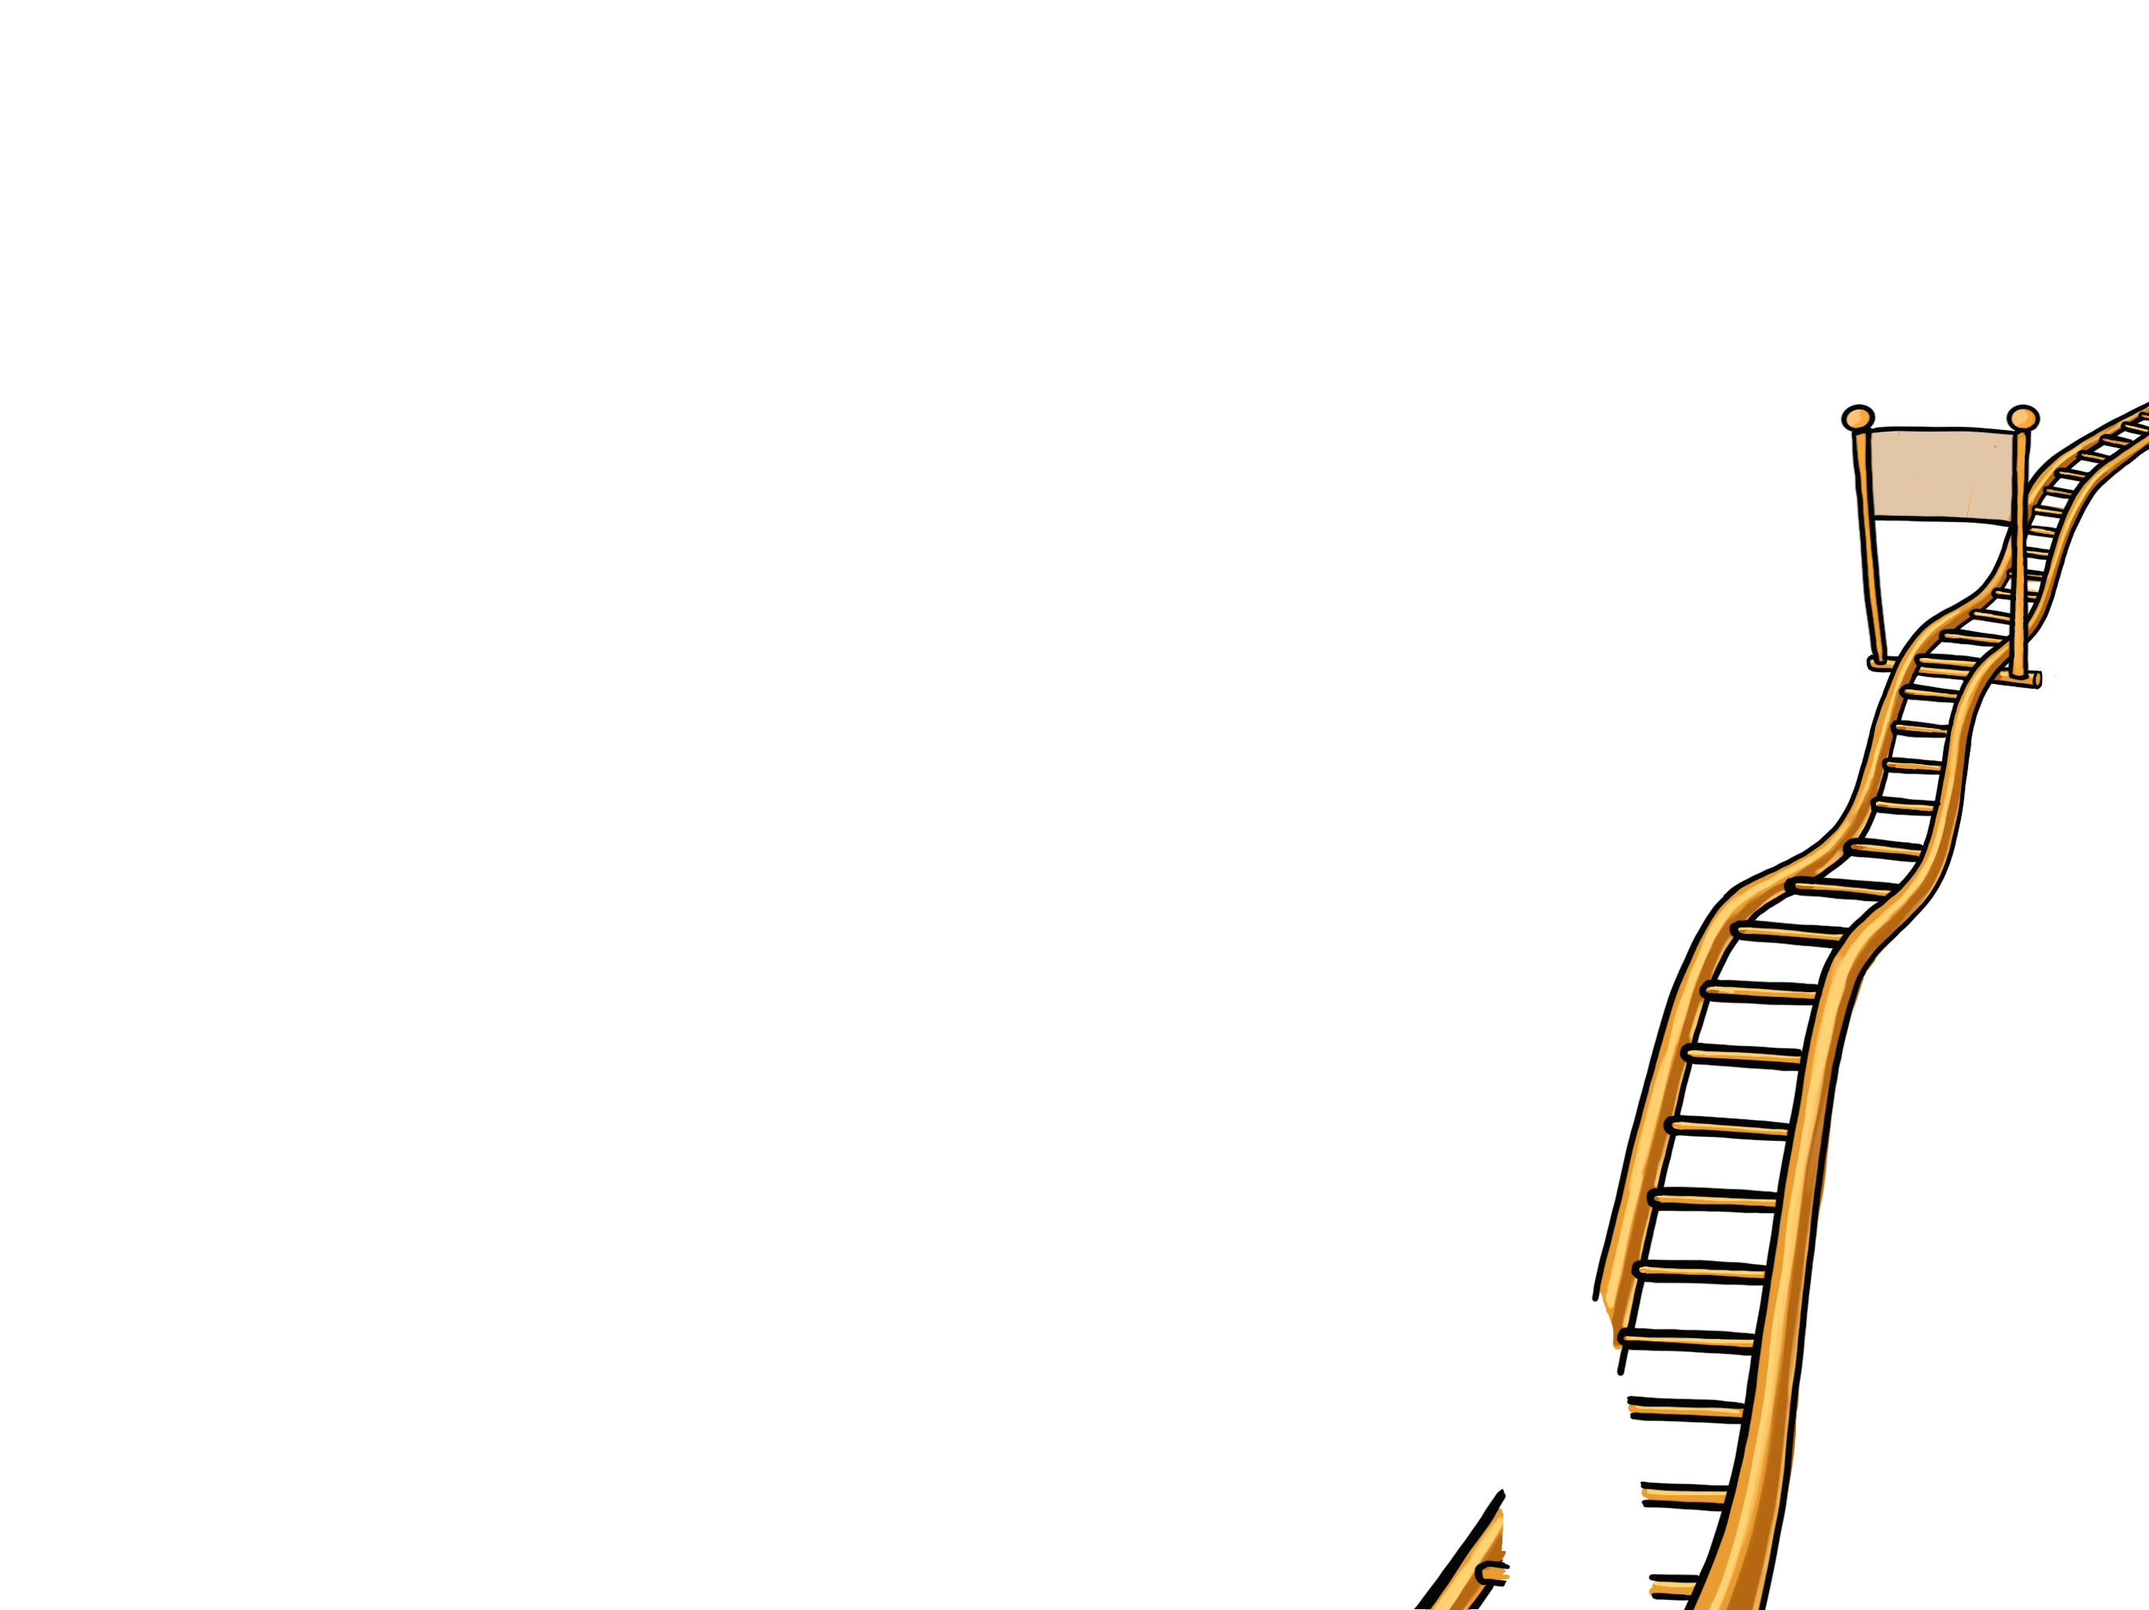
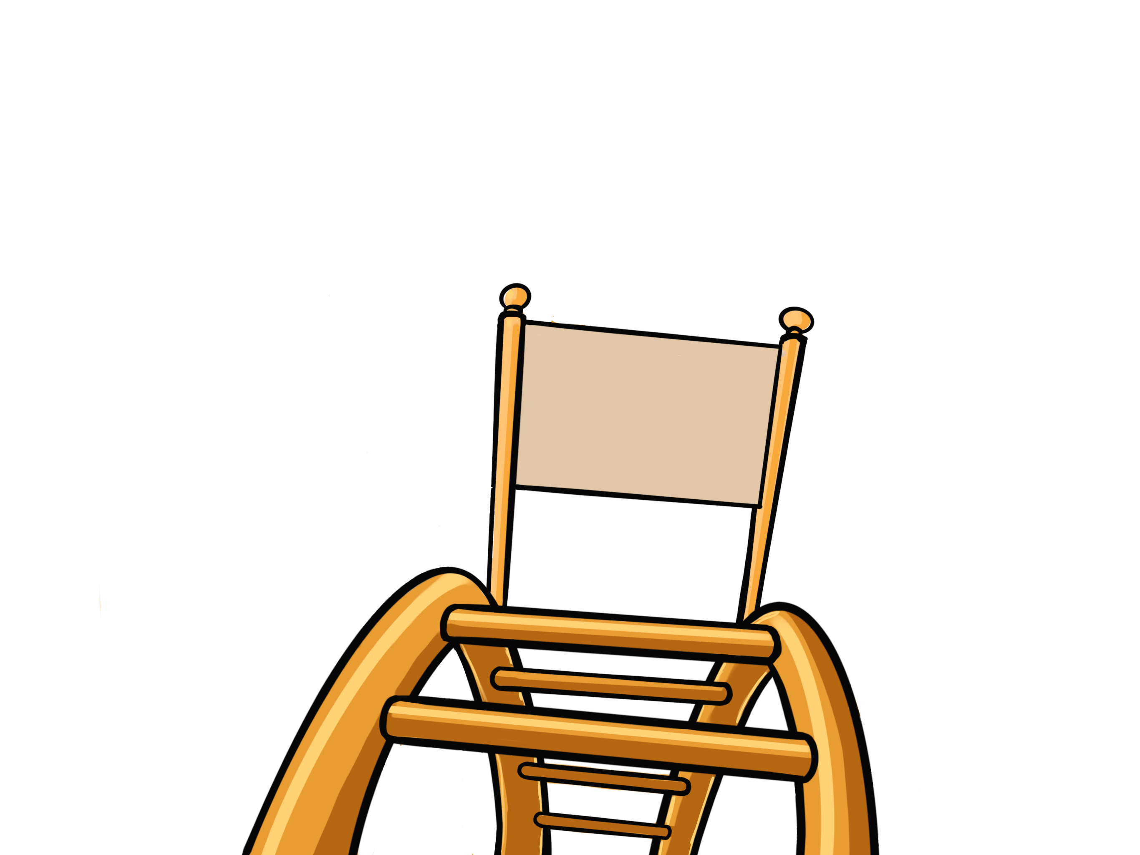
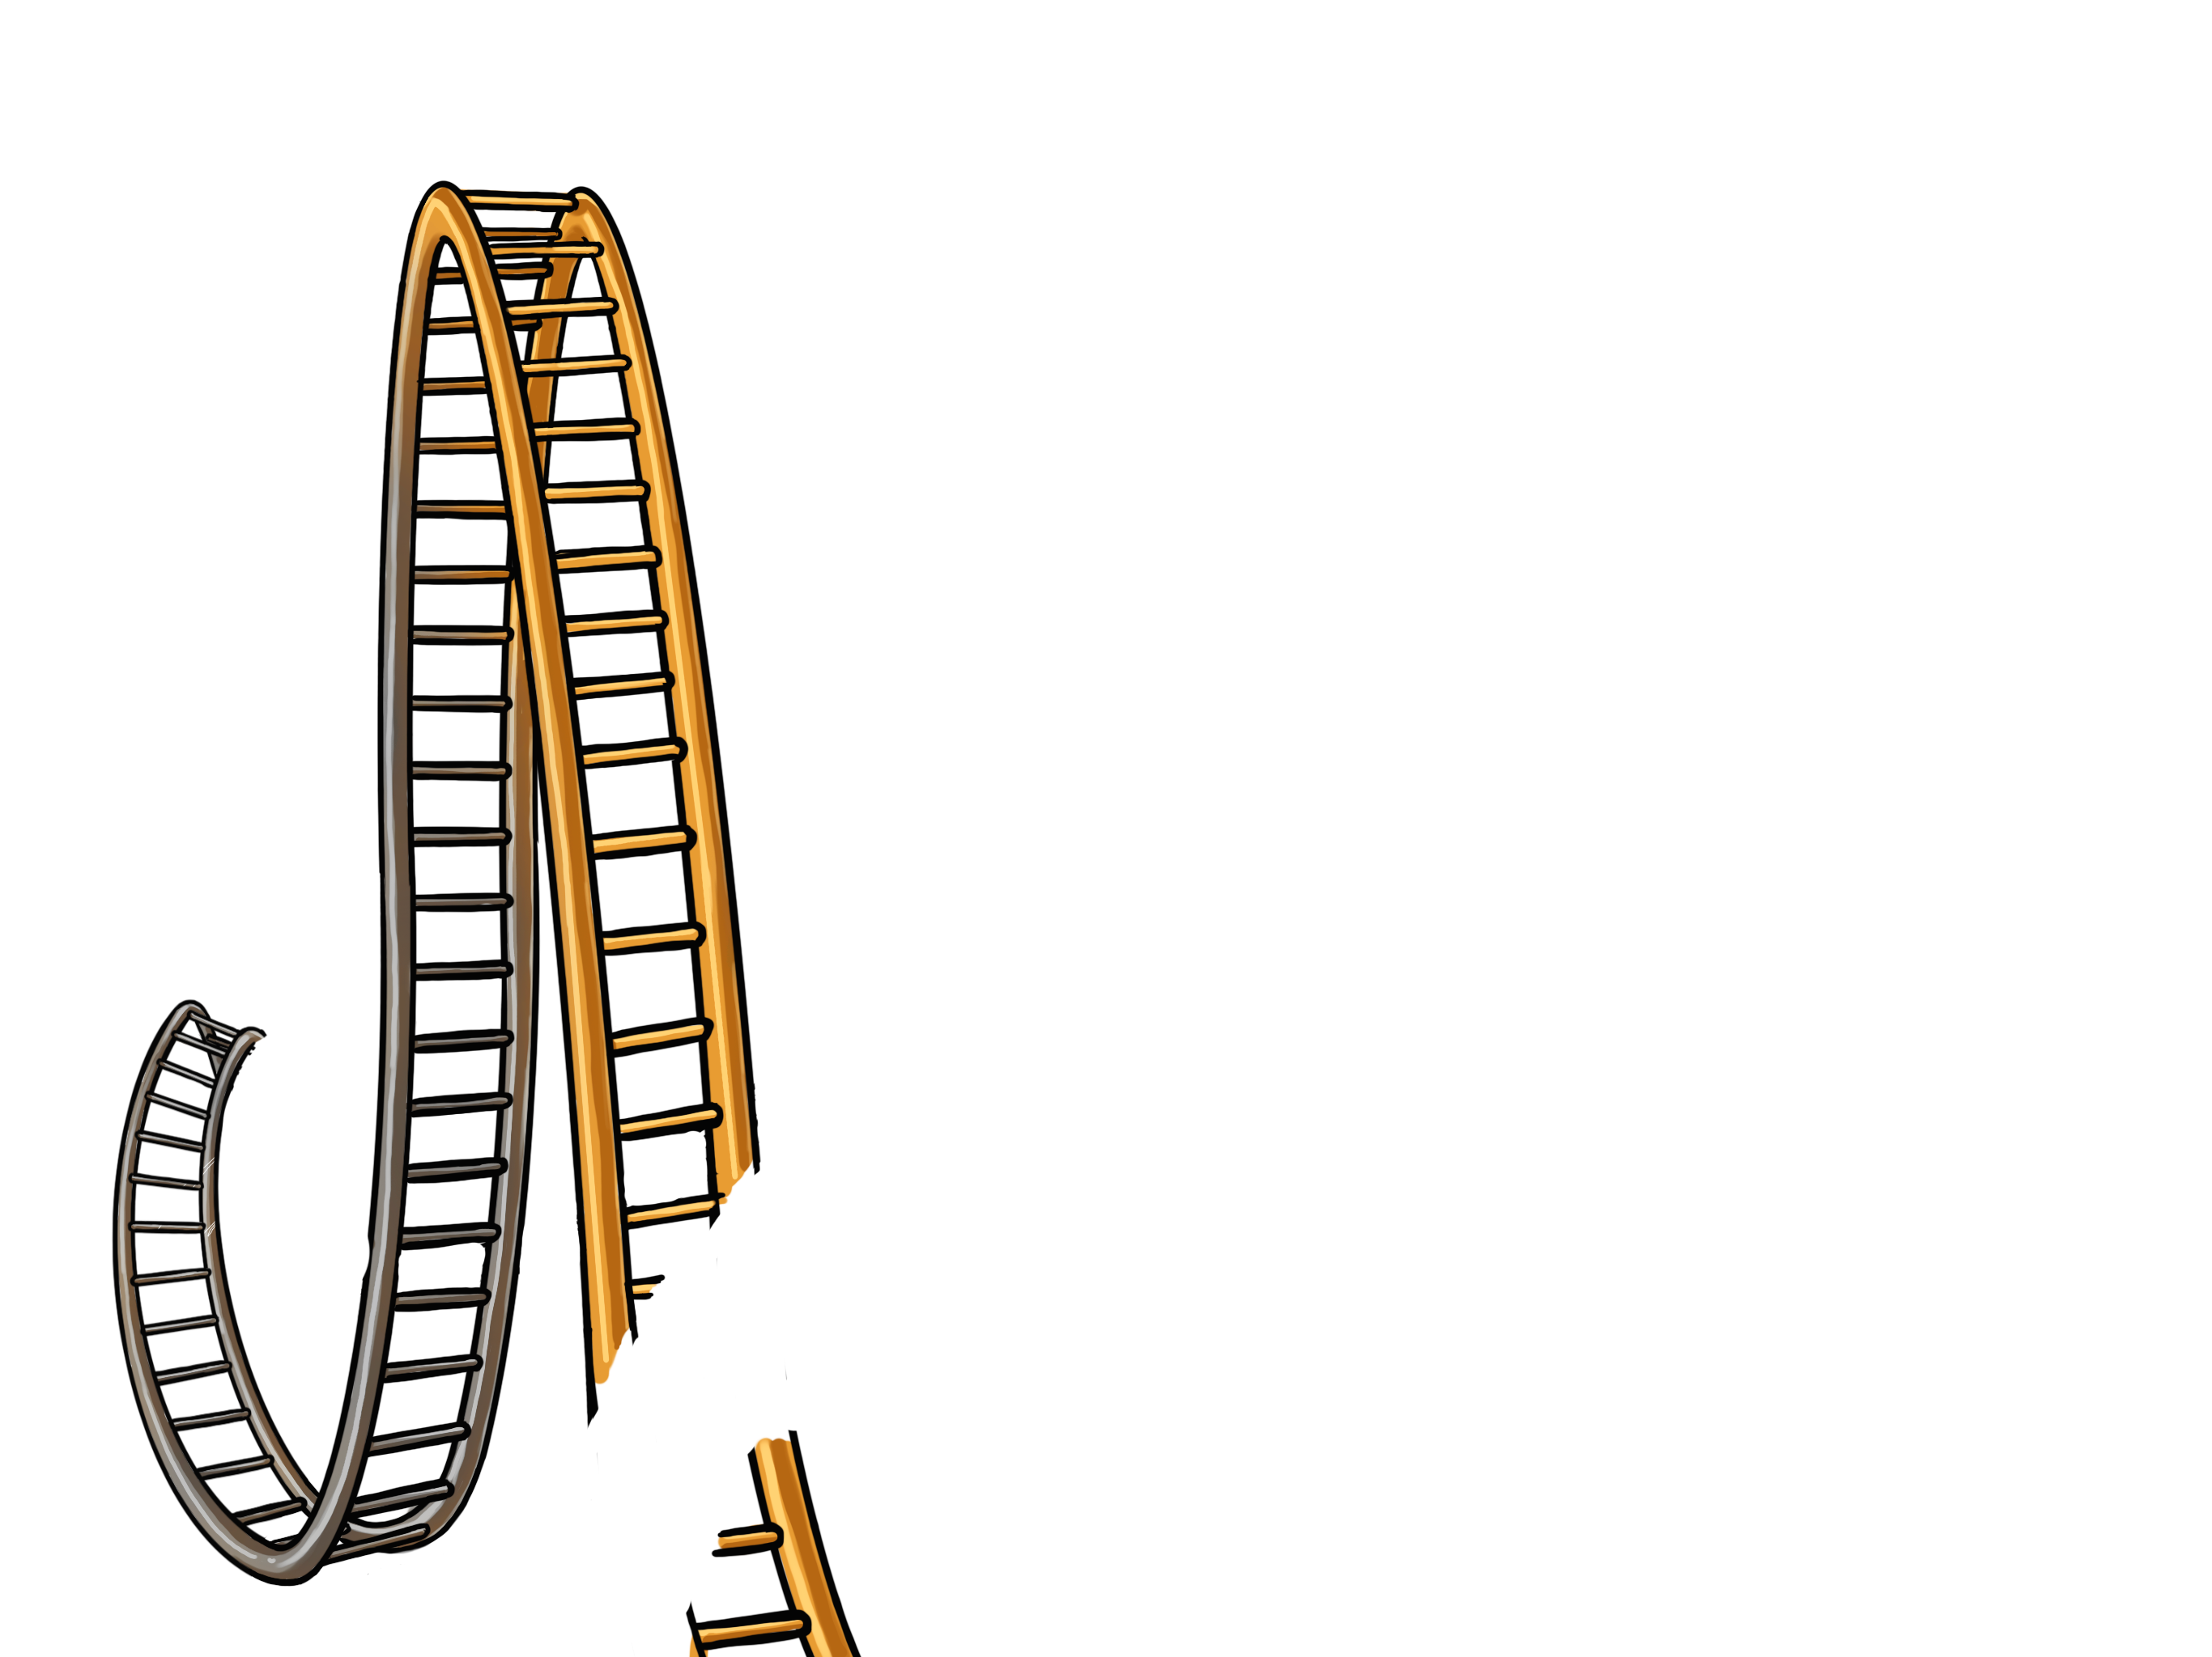
The Reality Ride
3
Goal
Stop
Think
Choose
4
2
1

