Slide 1
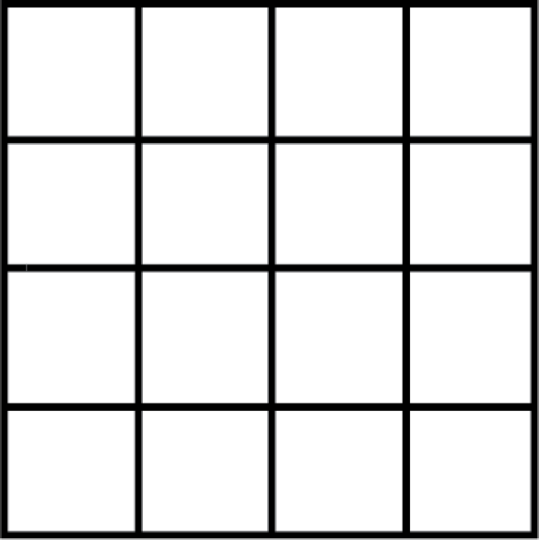
Flipping the Switch
Activity: Seeing Squares

Slide 2
Flipping the Switch
Activity: Seeing Squares
1

Slide 3
Flipping the Switch
Activity: Seeing Squares
1
+
16

Slide 4
Flipping the Switch
Activity: Seeing Squares
1
+
16

Slide 5
Flipping the Switch
Activity: Seeing Squares
1
+
16
+
9

Slide 6
Flipping the Switch
Activity: Seeing Squares
1
+
16
+
9
+
4
= 30

Slide 7
Flipping the Switch
Activity: Seeing Squares
Processing:
How many squares did you see at first?
How many squares did you see after you had some time to study the design?
Why did you keep seeing more squares?
Were you surprised by how many total squares were actually there?
How can looking at challenges differently give us more options?
How else does this activity relate to Flip the Switch?
Notes:
So the first step in becoming resilient is recognizing that inside of each of us is a switch. Another important part of the breakthrough that we have discovered relates to this battery.

