Slide 1
Motivation Formula
(Lesson Plan Template)

Slide 2
ATTENTION GETTER
Create your own attention-getter slide to start today’s lesson. This slide may include music, a story, an object lesson, a "Surrendering the One-up" activity, a group poll, or a brief movie clip.

Slide 3
Motivation Formula
Complete Metaphor
Animated Metaphor Walkthrough
Music
Learning
Journal
Video

Slide 4
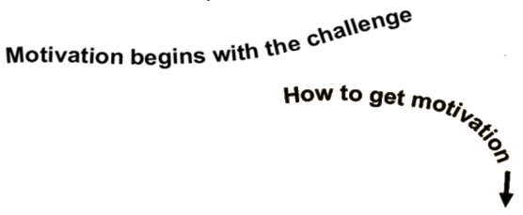
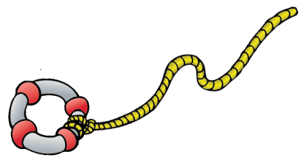
Negative
2
Positive
1
_{Choice}
Challenges
Anger
3
What Are Your Lifelines?
Damage
Who can help you out of the flood zone at home? At school? With your peers?
4
“The Flood Zone”
Less Opportunity and Freedom
Use Positive “Self Talk”
• Hurting self or others
• Less self-respect
• Energy dies
• Easy – “path of
least resistance”
Use your inner voice to direct your motivation (energy) in a positive direction (i.e. I will try). It’s a positive direction if you’re not hurting yourself or others)
Focus self-talk on what you do have control over.
5
Character
and Heart
You go through the motions and don’t give up out of respect for people who care about you.
You don’t give up out of respect for yourself.
6
A Passion Purpose or Interest
(Turn outward)
7
If channeled, challenges & anger can be converted into
WhyTry?
Get Plugged in “Support System”
Positive Motivation & Healing
Opportunity, Freedom, Self-respect

Slide 5
Negative
2
Positive
1
_{Choice}
Challenges
Anger
Damage
“The Flood Zone”
Less Opportunity and Freedom
• Hurting self or others
• Less self-respect
• Energy dies
• Easy – “path of
least resistance”

Slide 6
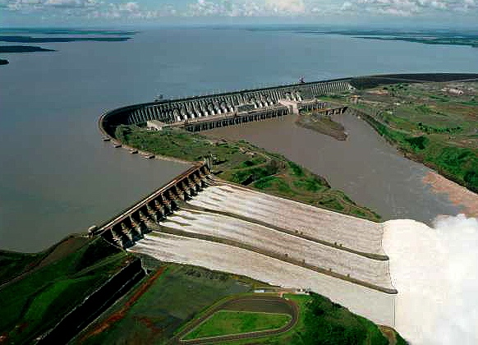
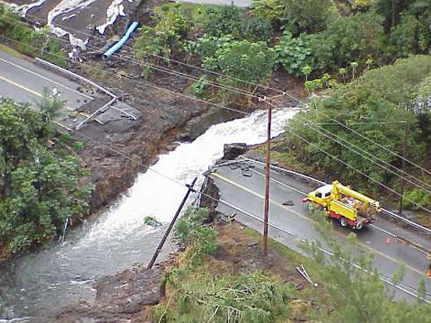
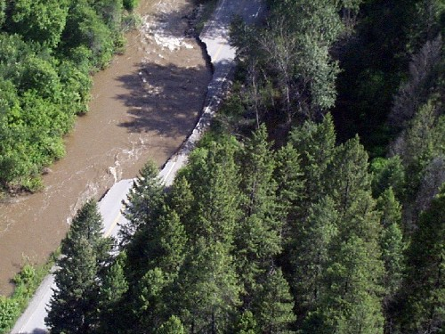
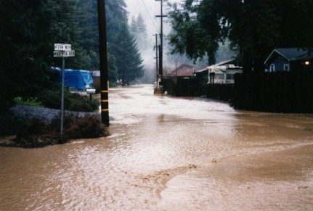
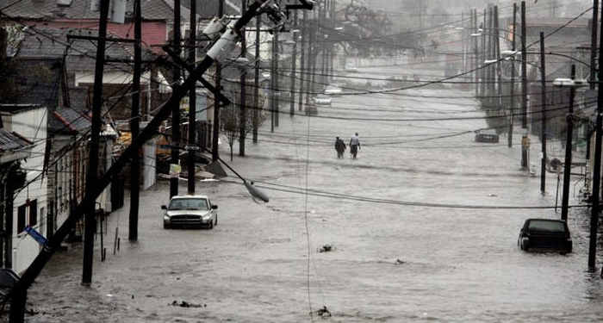
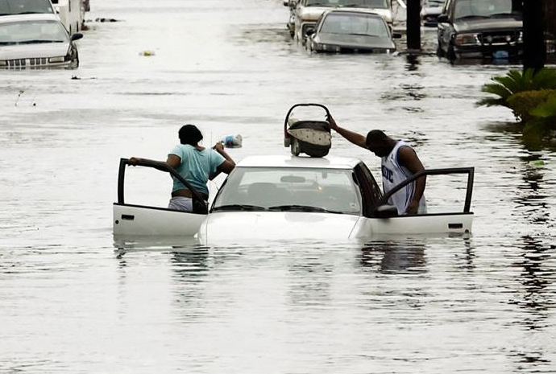
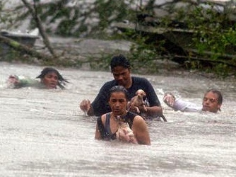
1
Challenges
“The Flood Zone”
Less Opportunity and Freedom
• Hurting self or others
• Less self-respect
• Energy dies
• Easy – “path of
least resistance”

Slide 7
Negative
2
Positive
1
_{Choice}
Challenges
Anger
3
What Are Your Lifelines?
Who can help you out of the flood zone at home? At school? With peers?
Damage
4
“The Flood Zone”
Less Opportunity and Freedom
Use Positive “Self Talk”
• Hurting self or others
• Less self-respect
• Energy dies
• Easy – “path of
least resistance”
Use your inner voice to direct your motivation (energy) in a positive direction (i.e. I will try). It’s a positive direction if you’re not hurting yourself or others)
Focus self-talk on what you do have control over.
5
Character
and Heart
You go through the motions and don’t give up out of respect for people who care about you.
You don’t give up out of respect for yourself.
6
A Passion Purpose or Interest
(Turn outward)
7
If channeled, challenges & anger can be converted into
WhyTry?
Get Plugged in “Support System”
Positive Motivation & Healing
Opportunity, Freedom, Self-respect

Slide 8
Music
Create your own music activity slide. This may include a WhyTry music video, a song of your own, or a song a student has shared.

Slide 9
Activity
Create your own learning activity slide. This may include either an object lesson, a group activity, or a group / movement activity. This slide may include instructions /rules for the activity or a relevant visual prompt to introduce the activity.

Slide 10
Journal
Create your own journal activity slide. This slide may include an art activity, observation activity, or game plan exercise from the WhyTry student journal. This slide may contain the actual journal page or a relevant visual prompt to introduce the journal activity.

Slide 11
Video
Create your own Video Activity slide. This slide may include one of WhyTry’s recommended YouTube clips that you have downloaded and embedded into this slide, or any other relevant video clip reinforcing some aspect of today’s lesson. Videos may be funny, serious, documentary style, etc. This is a good opportunity to differentiate your approach to best meet your student’s needs.

