Slide 1
Welcome To Class!
What’s your favorite book?

Slide 2
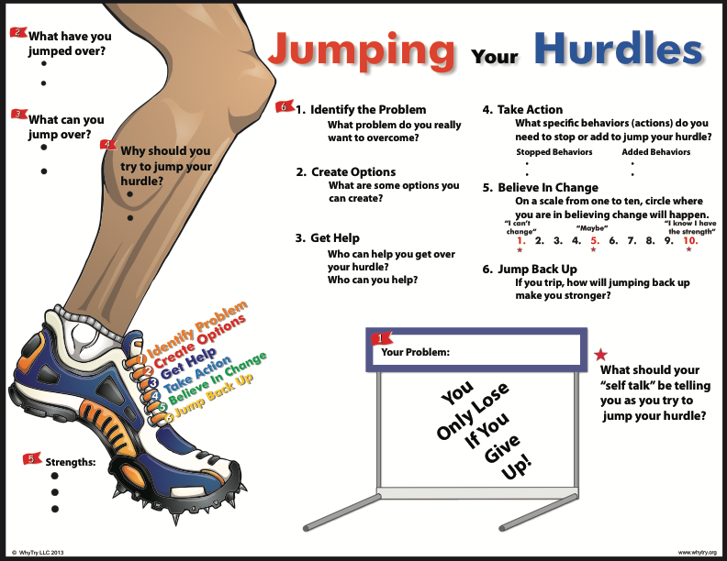

Slide 3
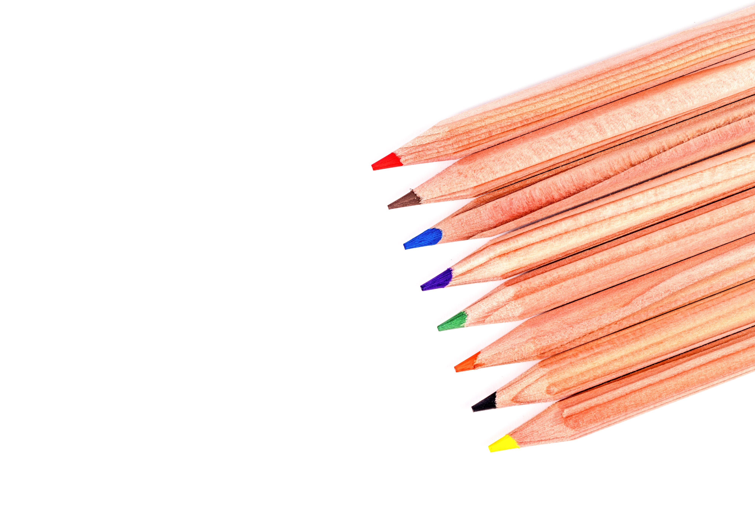
Activity: 15 pencils
I need one volunteer to play me in a game.

Slide 4
Activity: 15 pencils
What made this game difficult?
Where you able to figure out the pattern? If so, how?
How did you feel when class members continued to lose?
How does the pattern in this game apply to the formula for jumping hurdles?
Which will give us more success in life: Playing our luck or following the formula? Why?
What does this statement mean: “you only lose (fail) if you give up”?
What behaviors can you change to help you be successful? What behaviors can you keep in you life to help you achieve success?

Slide 5
Journal Activity
Create a list of people that you know you have jumped back up after their challenges. When you feel like giving up look up, to them for motivation.

Slide 6
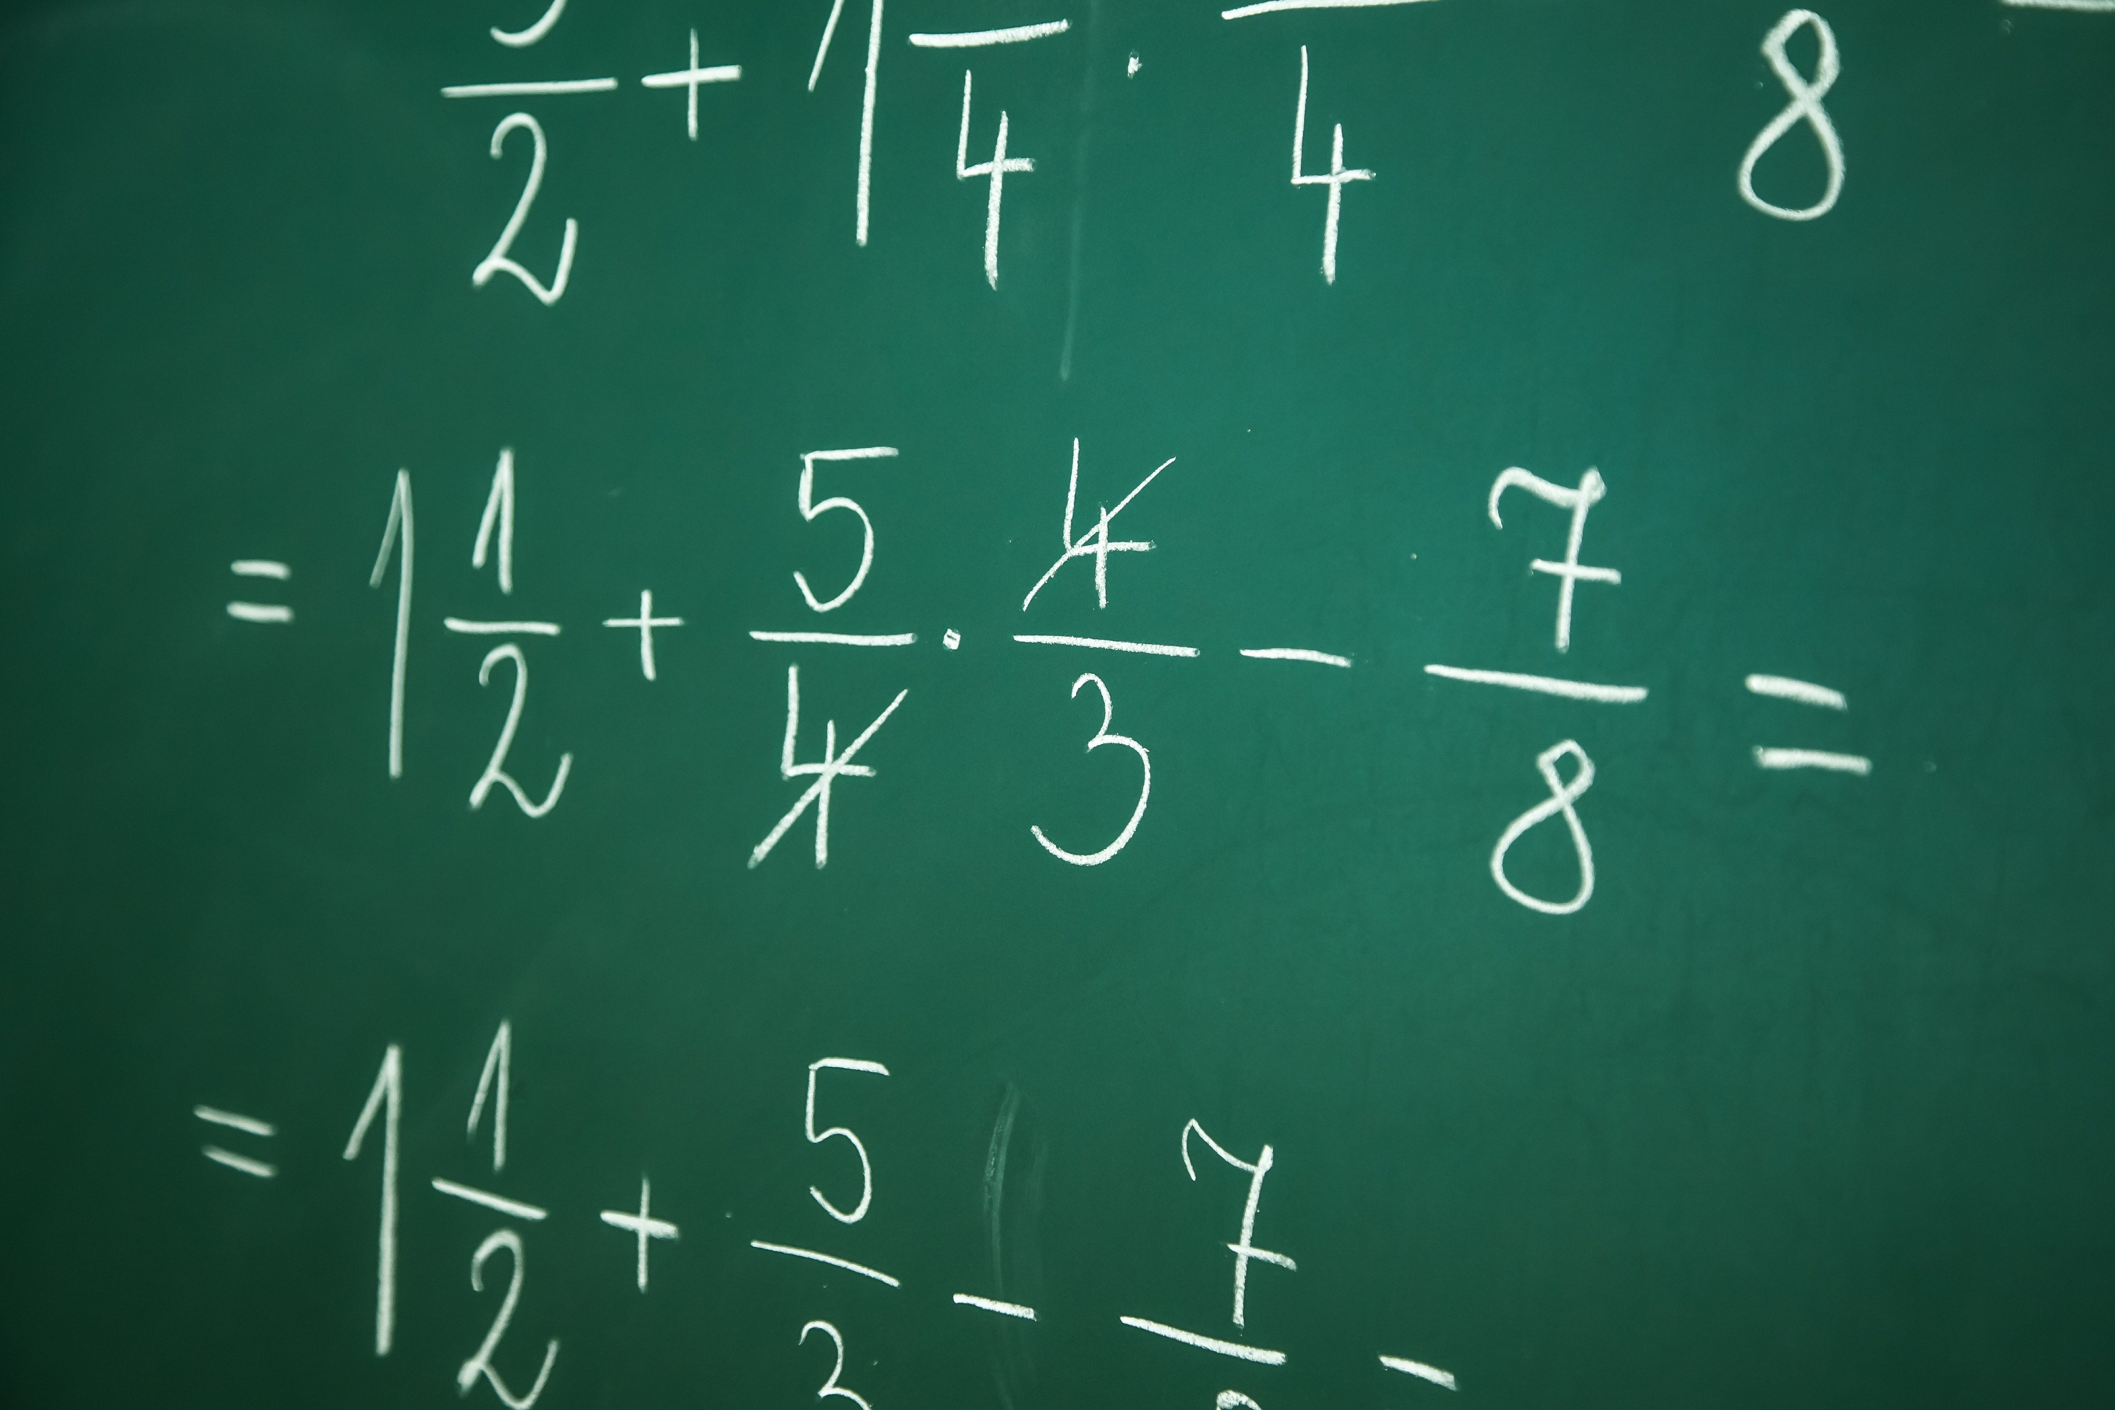
Alternate Activity: Math Problem
Pick a number between 1 and 10. Do not share the number with anyone.
Double the number.
Add 10.
Divide by 2.
Subtract the number you started with.
Add 11.

Slide 7
Alternate Activity: Math Problem
For those of you that did the math right, why did you ge the answer of 16?
What happened to the rest of you?
Who was in control of the activity, you or me?
Who is in control of your own life?
What are the steps that successful people follow to overcome challenges or hurdles in their lives?

Slide 8
Alternate Activity: Circle Around a Problem
Write a realistic, achievable problem you want to over come on the card.
On a scale of 1 to 10 is your desire to overcome the problem a 7 or higher?
If its not pick another problem you want to overcome.
Stand in the circle with your heels on the tape facing the middle of the circle.
Lie down and place your heels on the tape with the bottom of your shoes facing the middle of the circle.
Place your card face up on the ground under your head like a pillow.
Stand up and step inside the circle.
Work as a team to retrieve your cards, only the person who wrote the card can pick it up and if any body part touches outside the circle you have to put the card back in its place and try again.

Slide 9
Alternate Activity: Circle Around a Problem
What Strategies did you use to overcome the problem?
what were your fears when it was your turn to pick up your card?
How did it feel when you reached your goal and brought it back to the middle of the circle?
What had to happen before you reach or overcame your problem?
Why cant the difficult problems in life be reached without support?
Can you overcome your challenge/problem on your own? How is they activity like life?
What happens if your are not successful in your attempt to overcome your problem the first time?
Who are you support stems in life to help you overcome your problems?

Slide 10
Thank for Coming!

